Slide 1



Slide 2

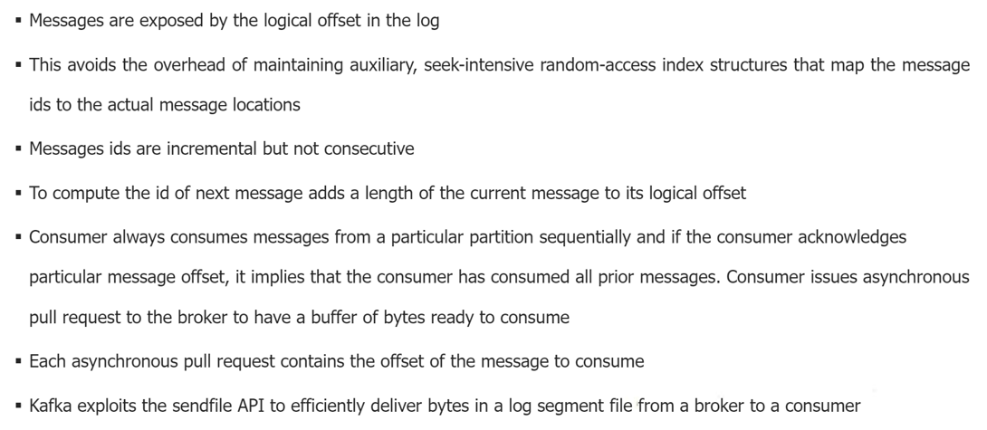
Kafka - Offset

Slide 3
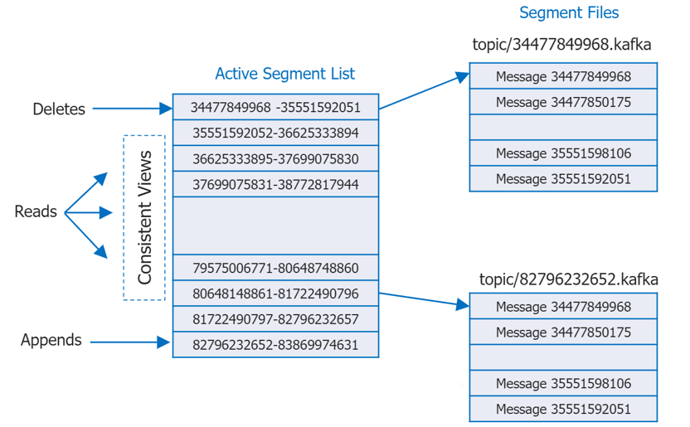
Kafka - Offset

Slide 4
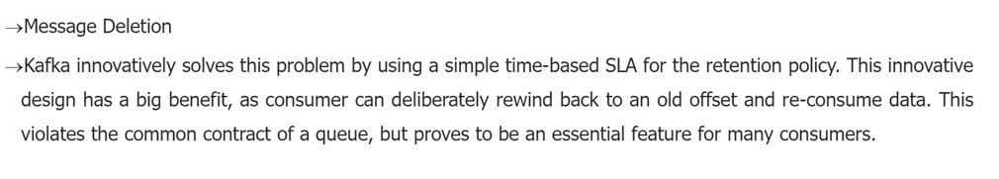
Kafka - Design

Slide 5
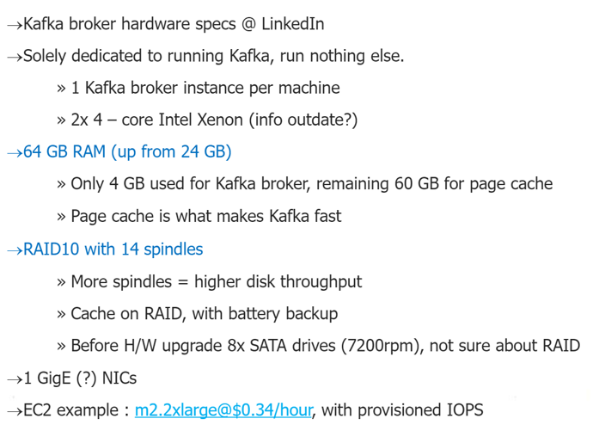
Kafka - Hardware

Slide 6
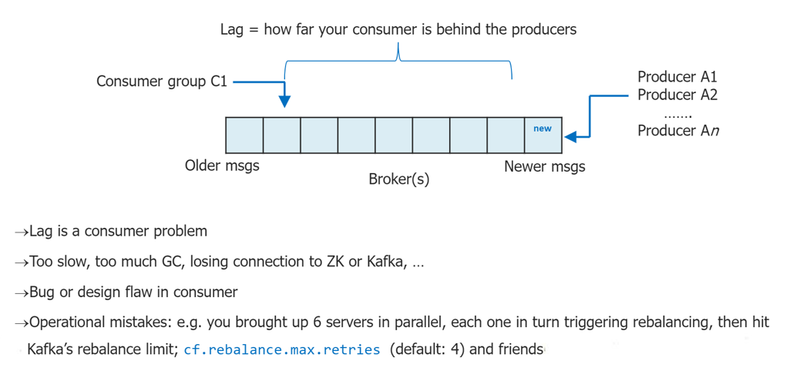
Kafka – Monitoring and Issues

Slide 7
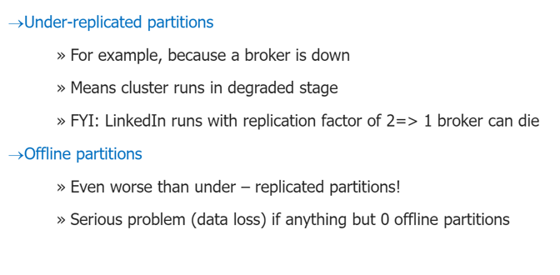
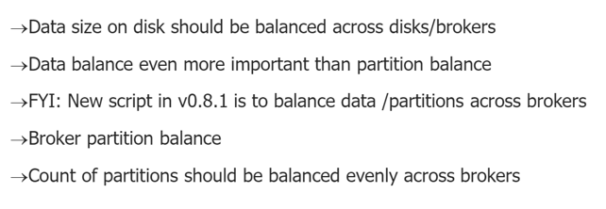
Kafka – Monitoring

Slide 8
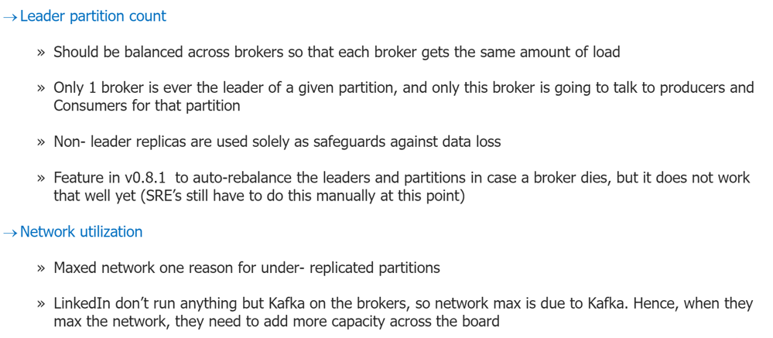
Kafka – Monitoring

Slide 9
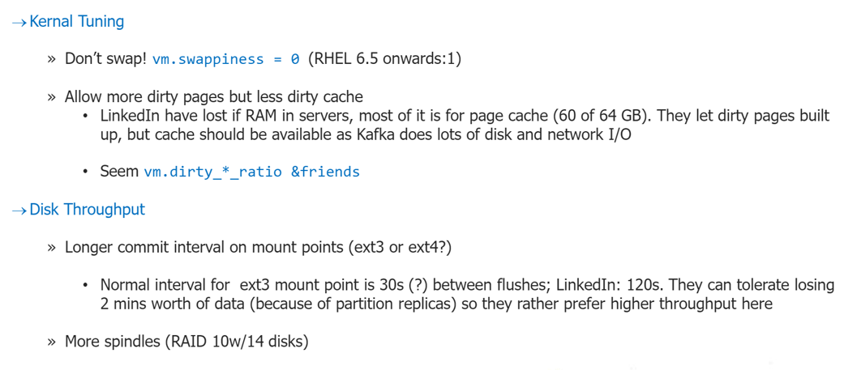
Kafka – Performance Tuning

Slide 10
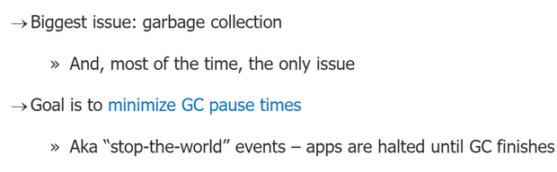
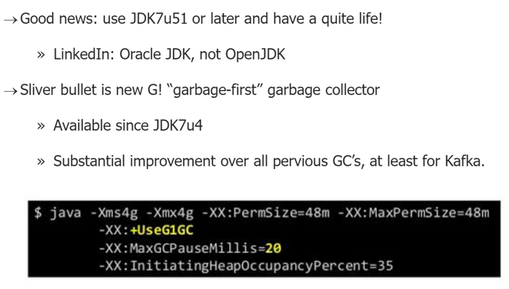
Java / JVM Tuning

Slide 11
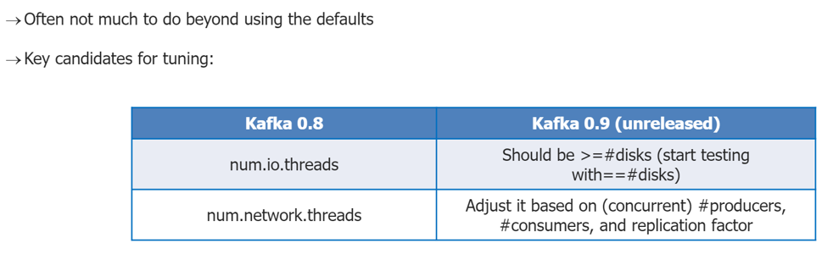
Kafka Configuration Tuning

Slide 12
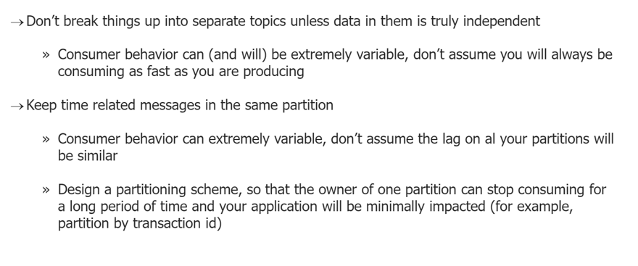
Kafka Usage Tuning

Slide 13
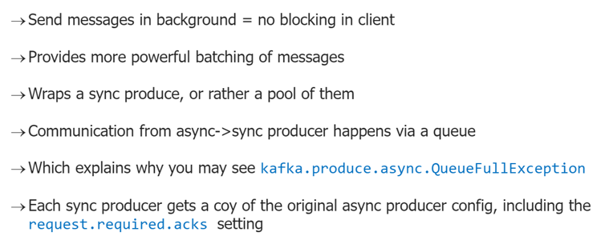
Async Producer

Slide 14
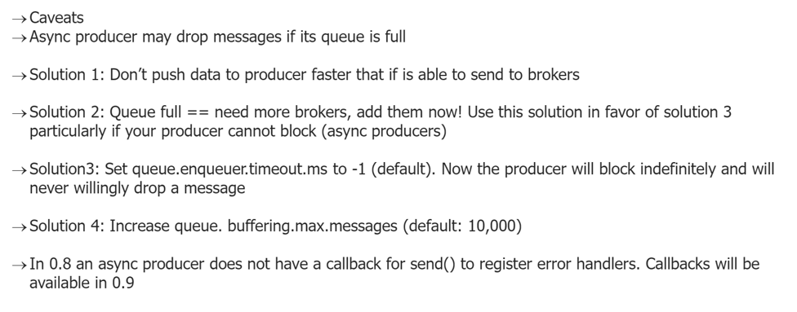
Async Producer

Slide 15
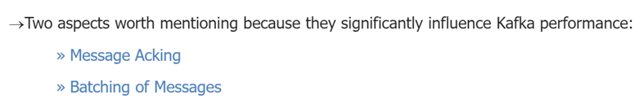
Producer

Slide 16
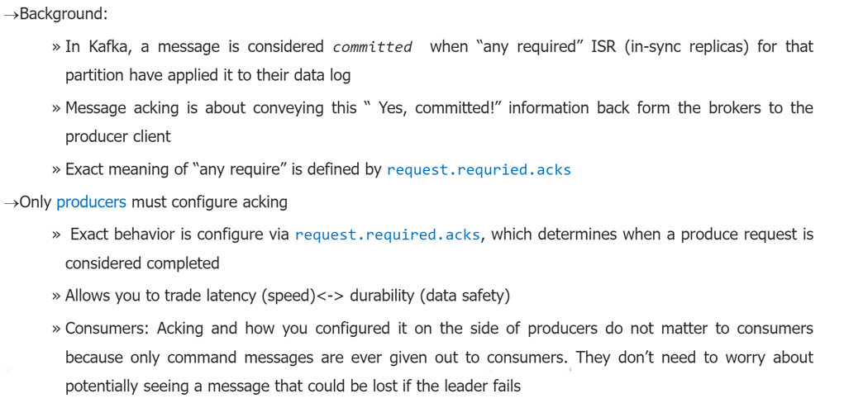
Message Acking

Slide 17
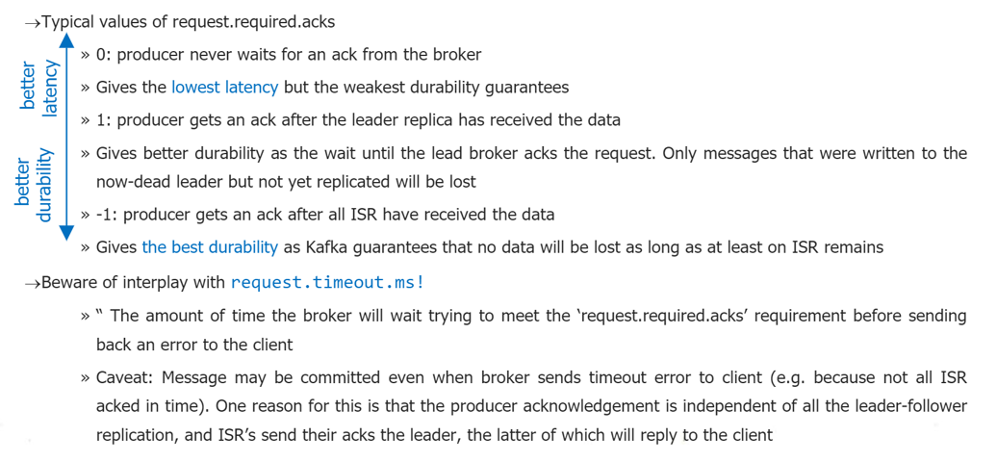
Message Acking

Slide 18
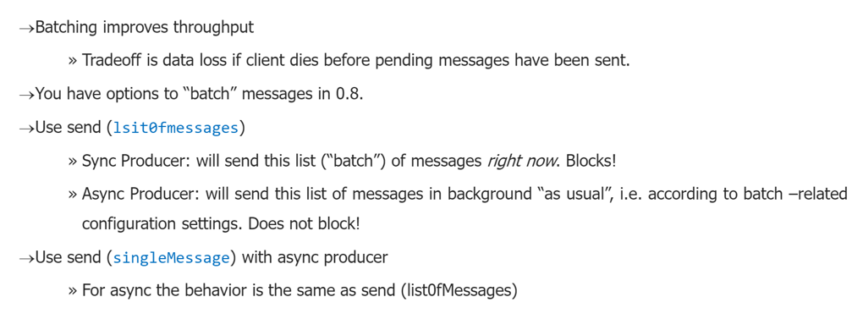
Batching of Messages

Slide 19
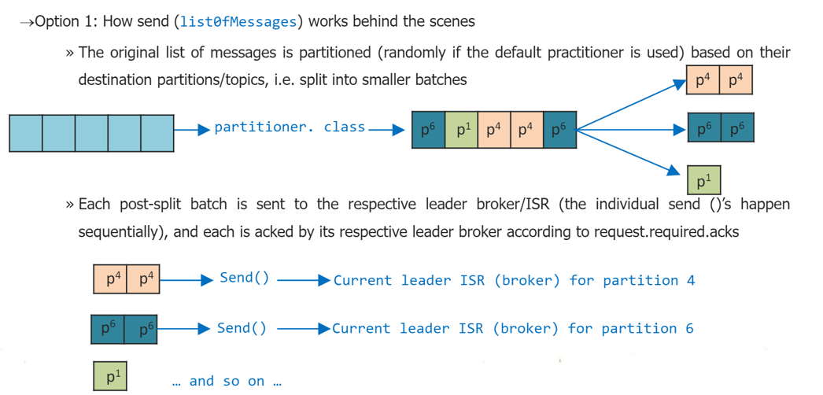
Batching of Messages

Slide 20
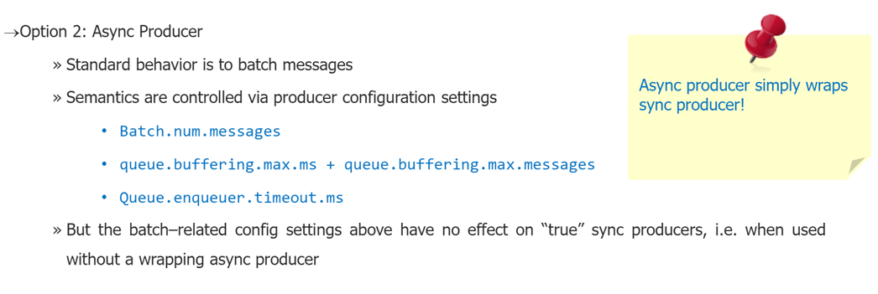
Batching of Messages

Slide 21
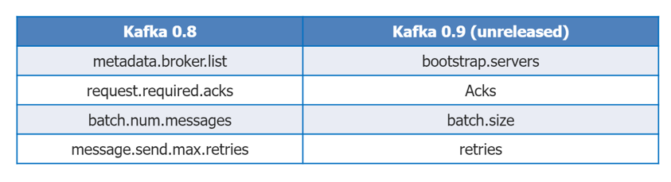
Upcoming Producer Configuration Changes

Slide 22
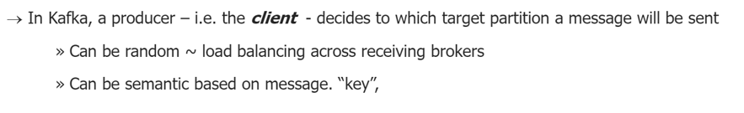
How to know the right Partition when sending?

Slide 23
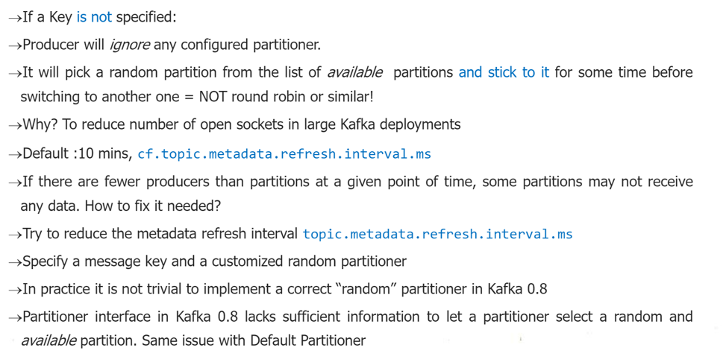
Keyed Vs. non-Keyed messages in Kafka 0.8

Slide 24
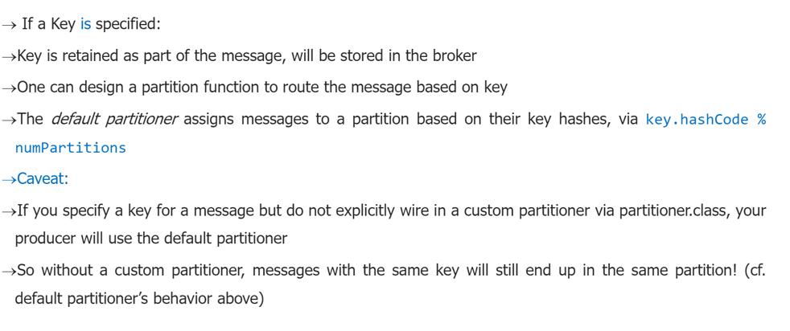
Keyed Vs. non-Keyed messages in Kafka 0.8

Slide 25
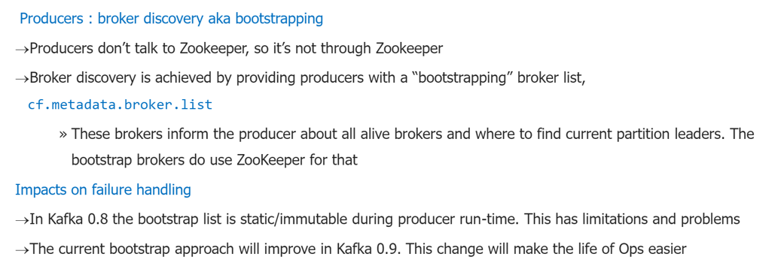
How to know the Current Leader of a Partition

Slide 26
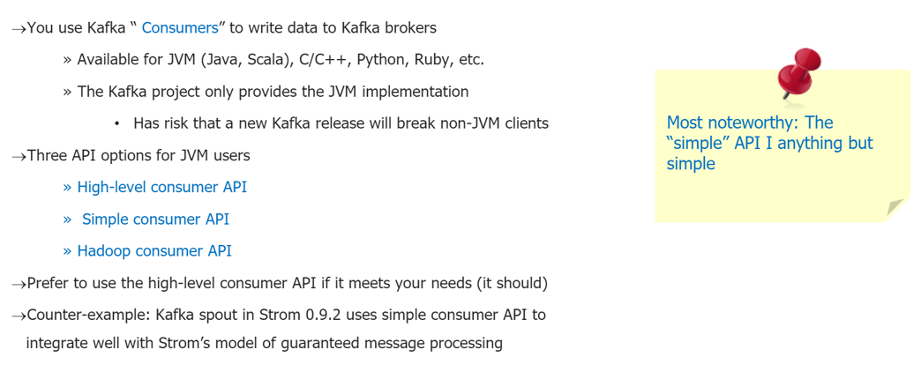
Reading Data from Kafka

Slide 27
Reading Data from Kafka

